Slide 1
HERITAGE QUEST
Free through your public library and available to use from home.

Slide 2
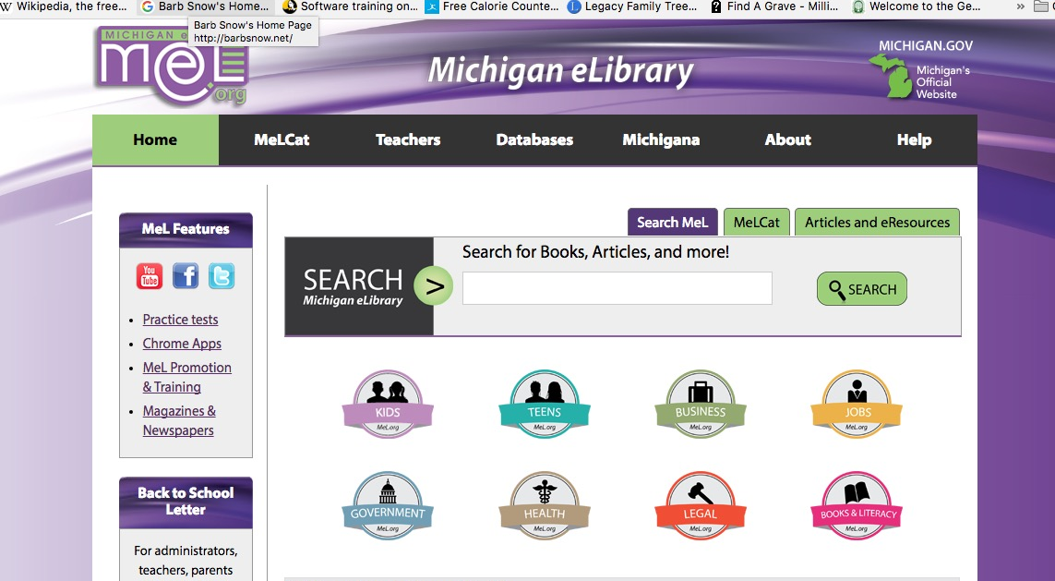
Michigan Residents: MEL.og

Slide 3
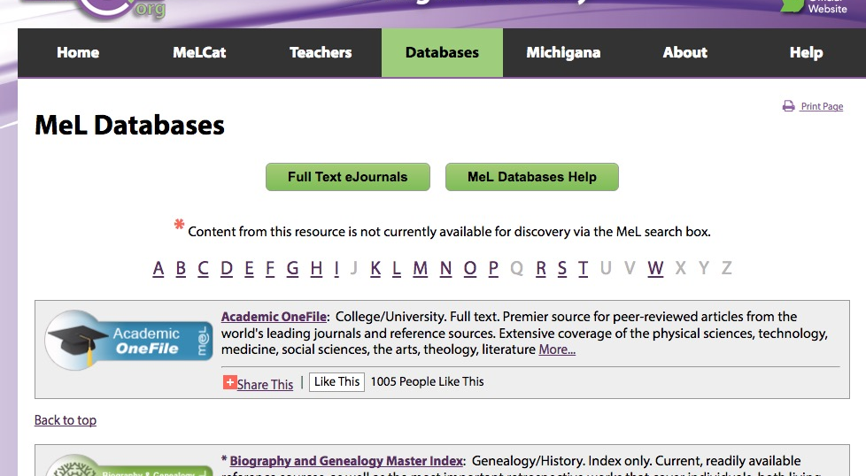
H for Heritage Quest

Slide 4
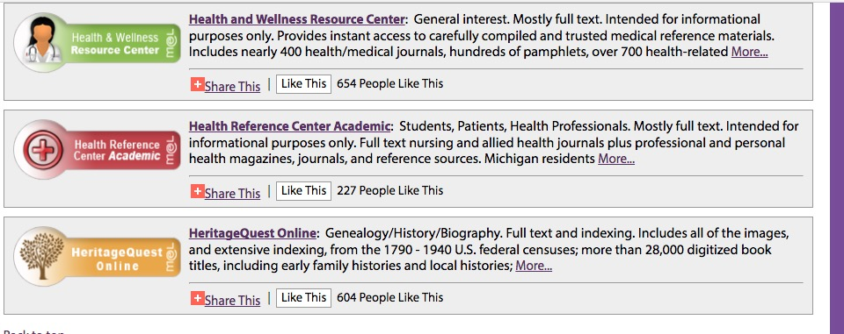
Select Heritage Quest Online

Slide 5
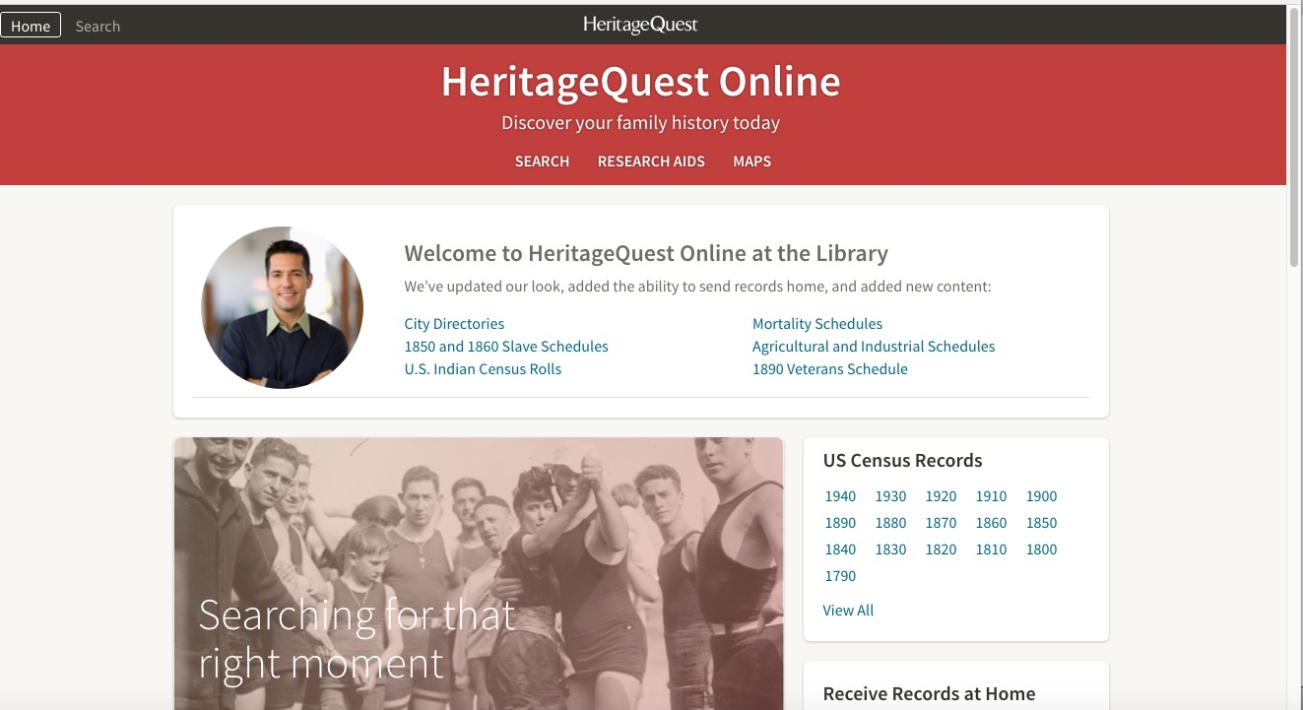
Splash Screen is HOME

Slide 6
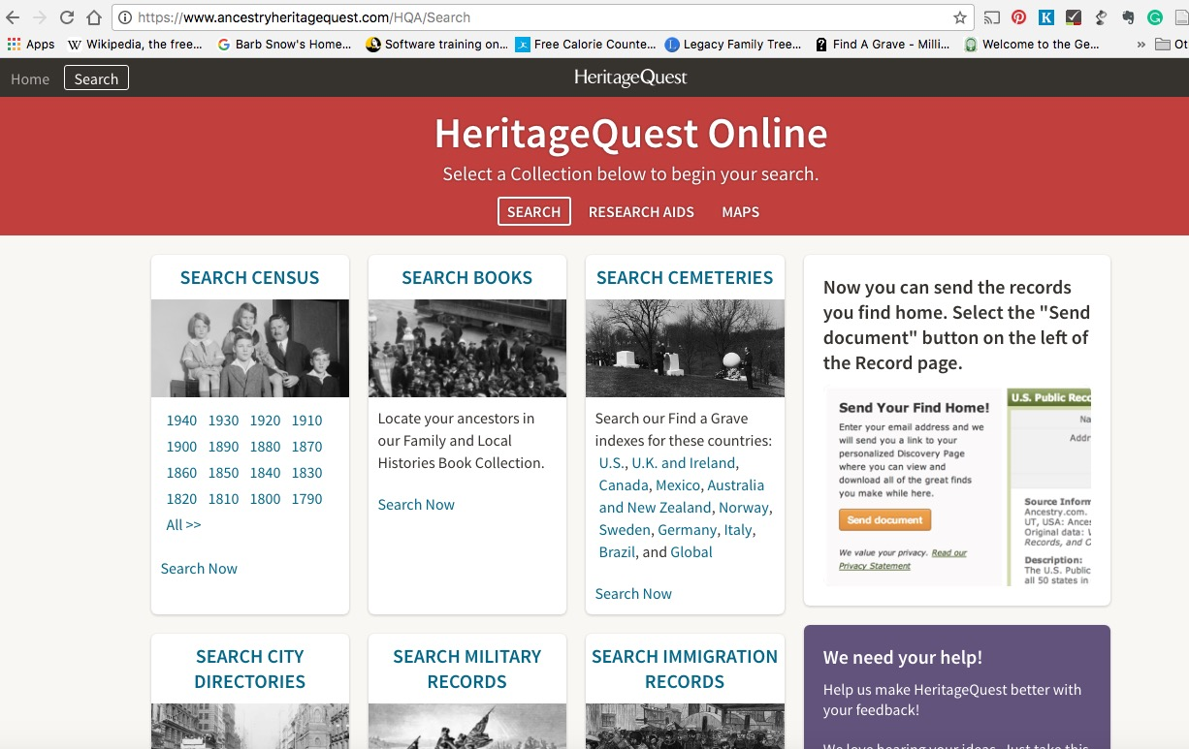
Search Screen

Slide 7
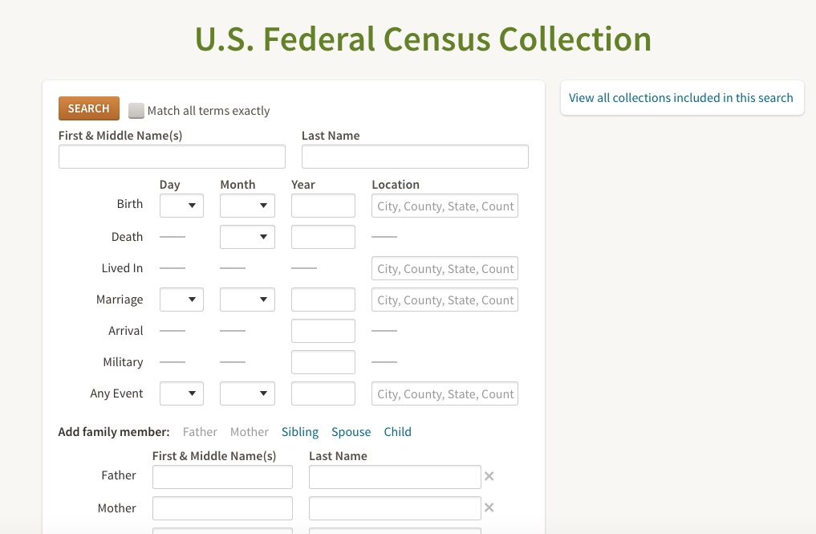
Search Census

Slide 8
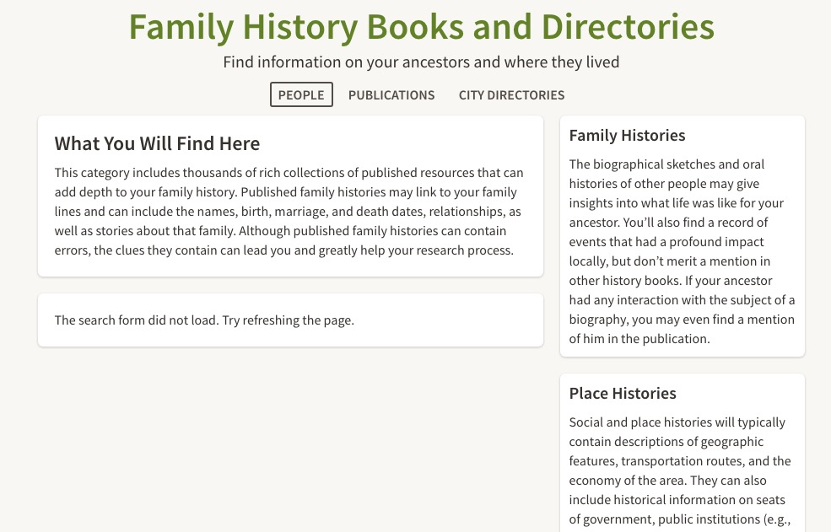
Search Books

Slide 9
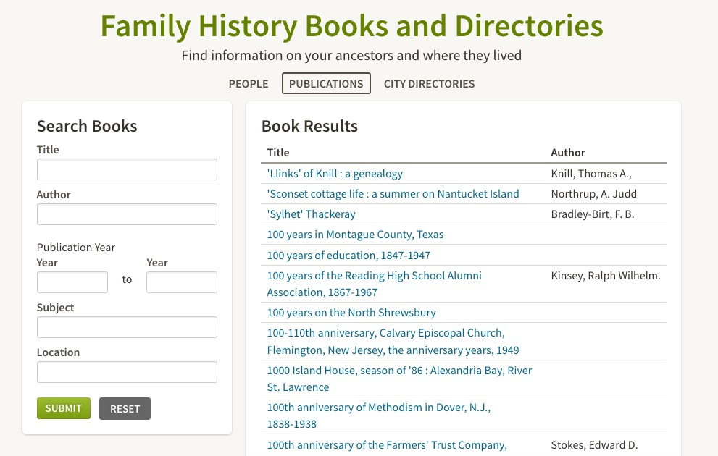
Search Books -- Publications

Slide 10
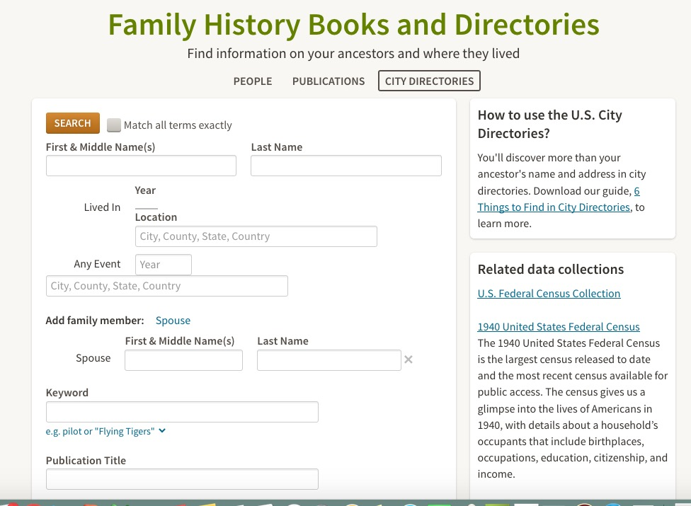
Search Books City Directories

Slide 11
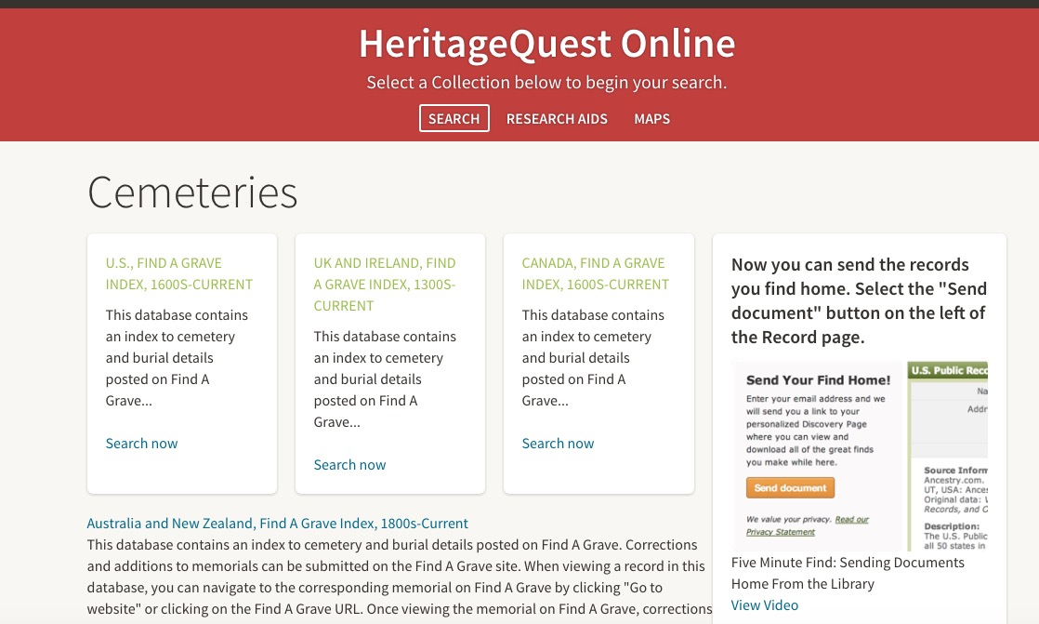
Search Cemeteries

Slide 12
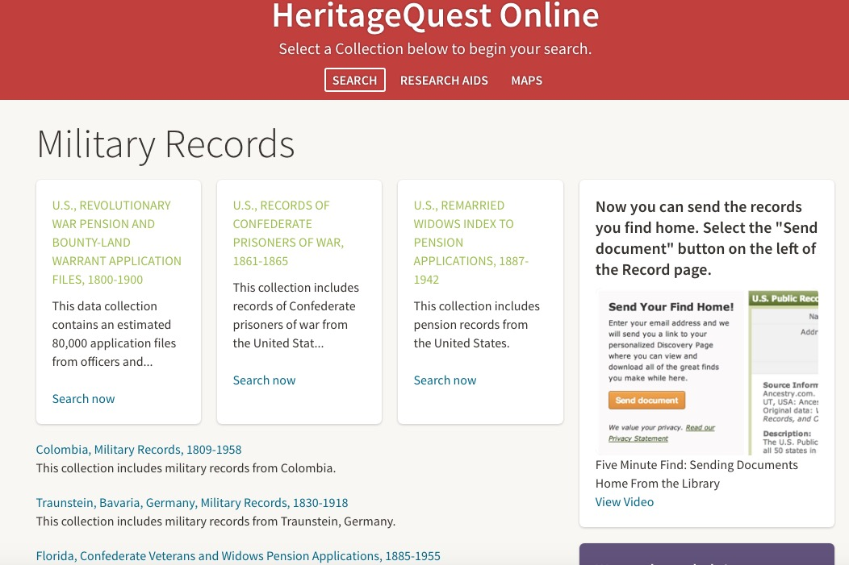
Search Military Records

Slide 13
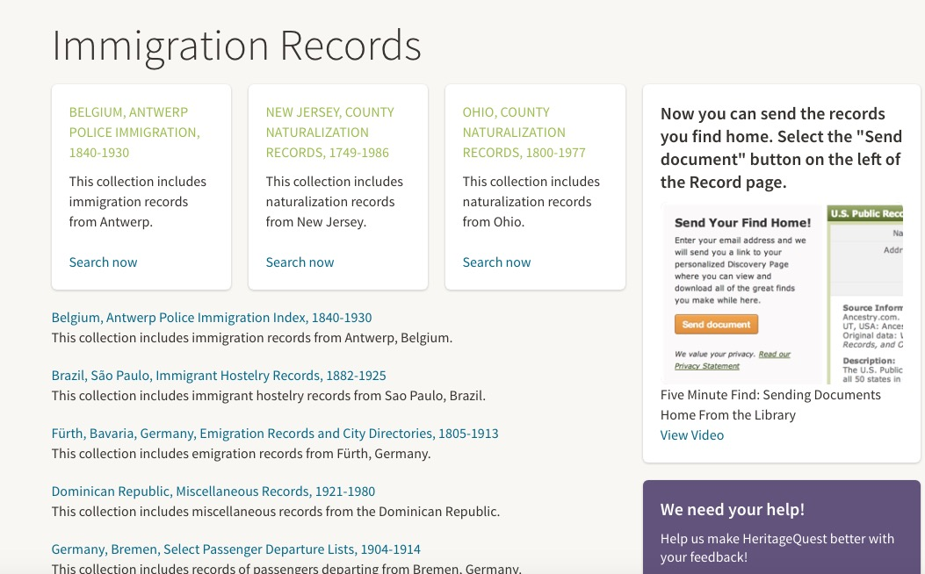
Search Immigration Records

Slide 14
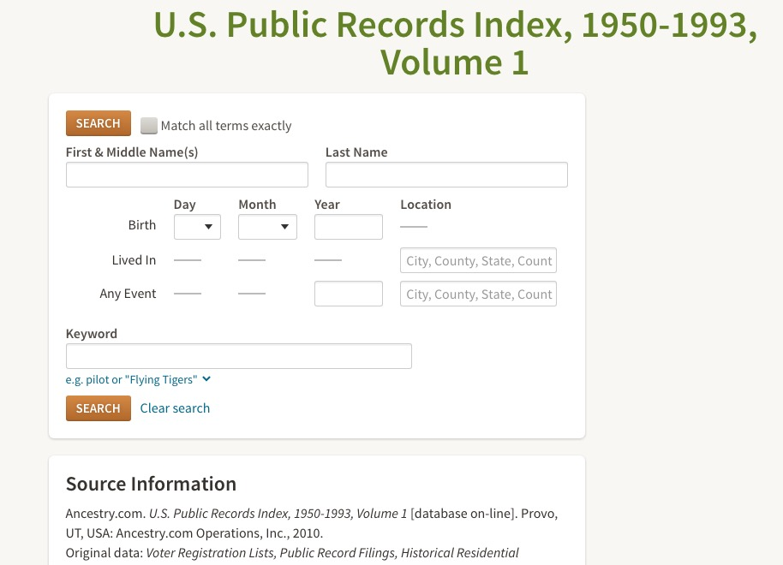
Search recent address records

Slide 15
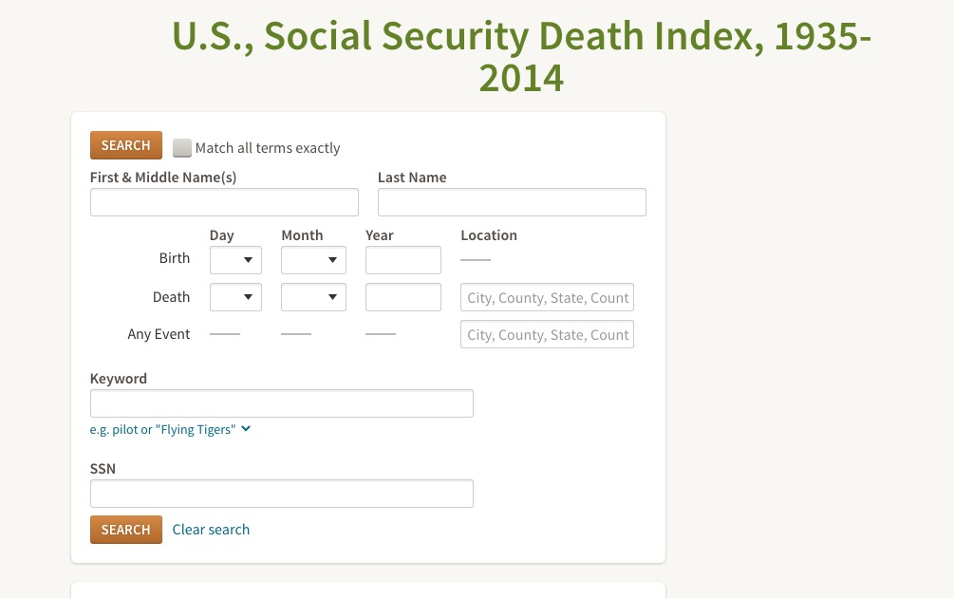
Search SSDI

Slide 16
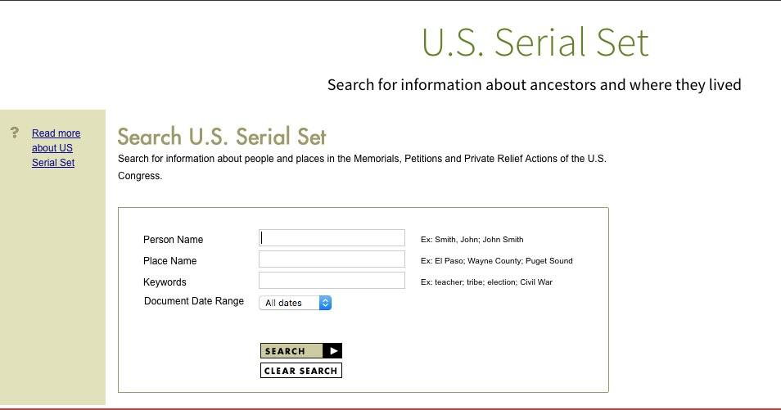
Search U.S. Serial Set

Slide 17
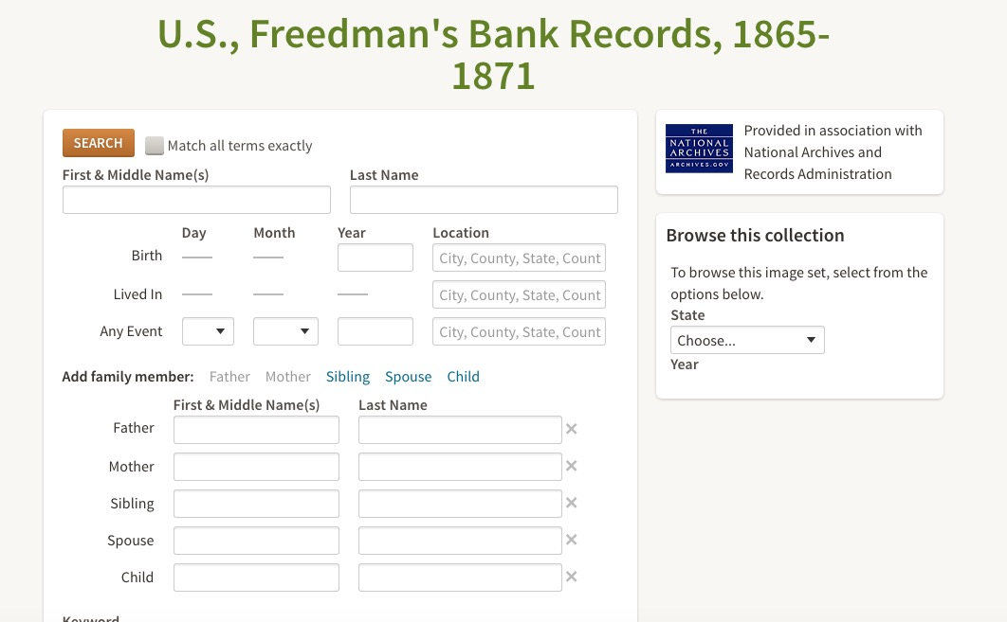
Search Freedman’s Bank Records

Slide 18
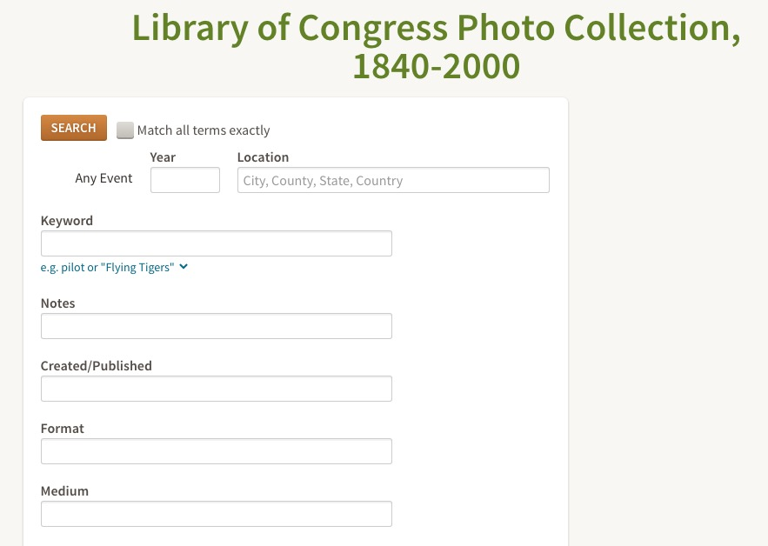
Search Photos

Slide 19
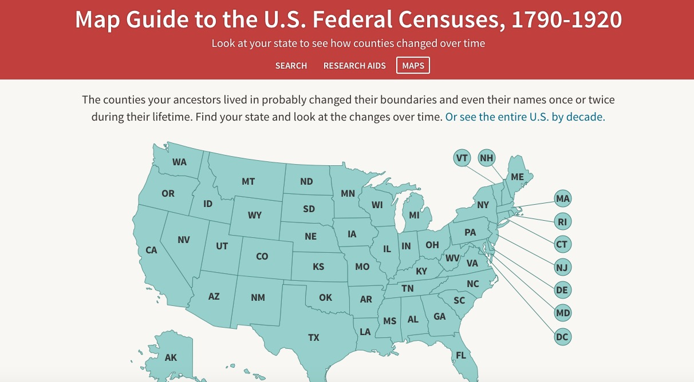
Search Maps (county boundary lines)

Slide 20
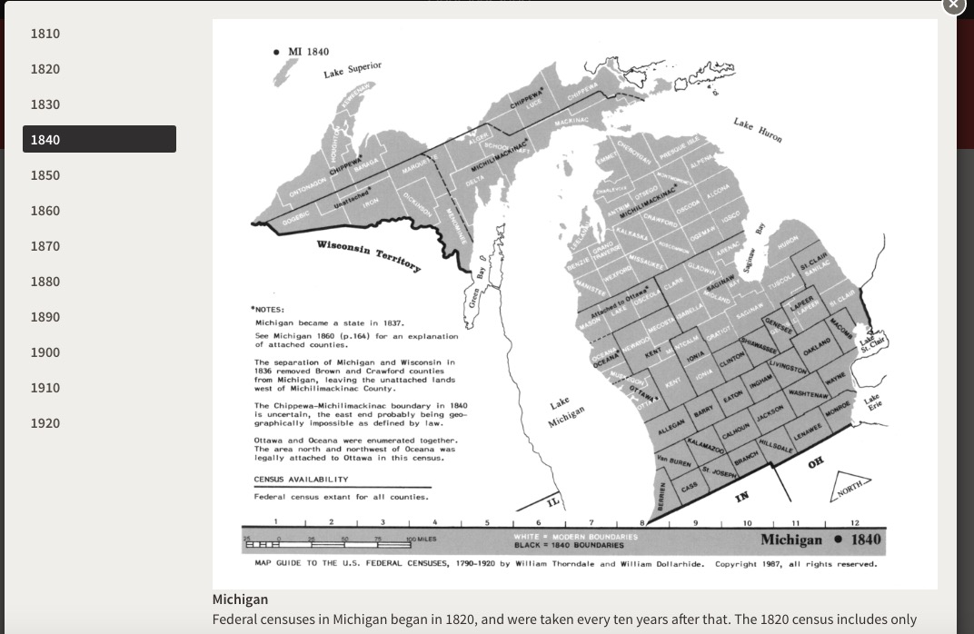
Sample Map… Michigan 1840

Slide 21
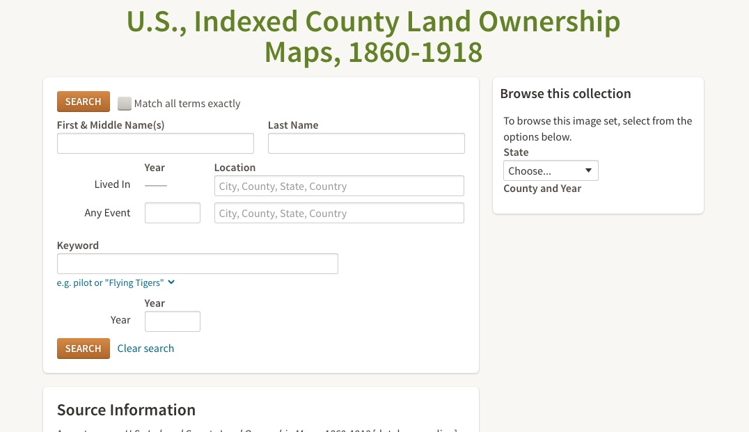
Search and ownership maps

Slide 22
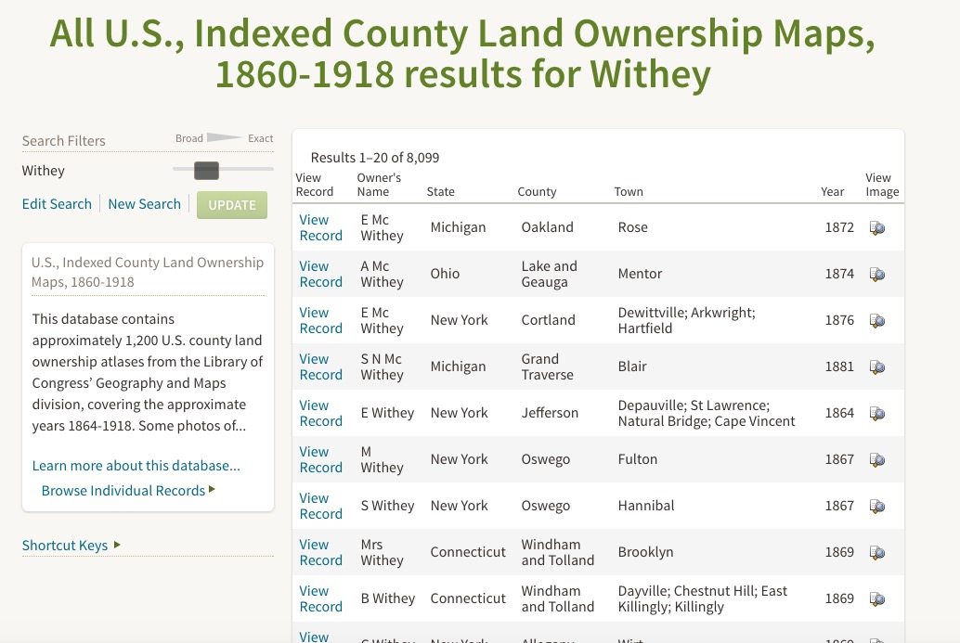
Search for Withey

Slide 23
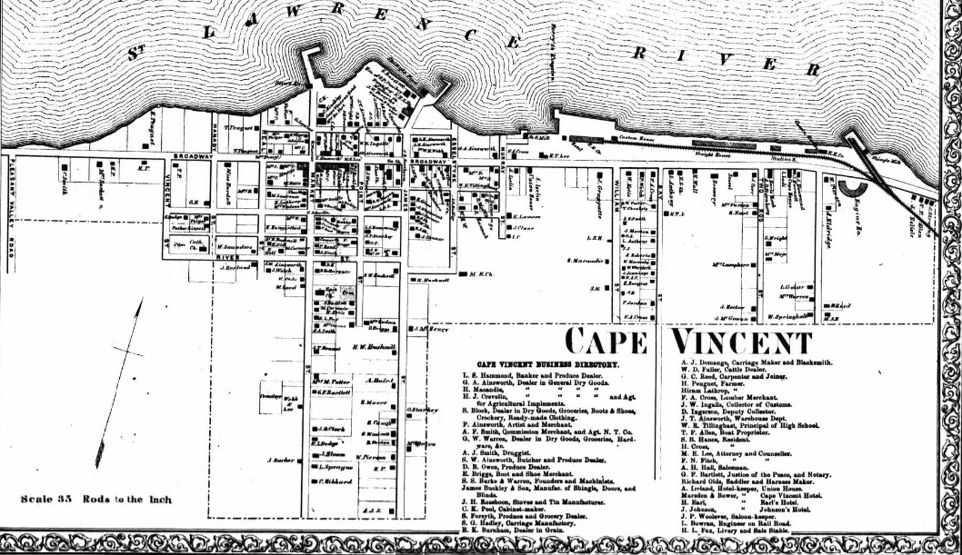
Where my GGGGrandfather was in 1864

Slide 24
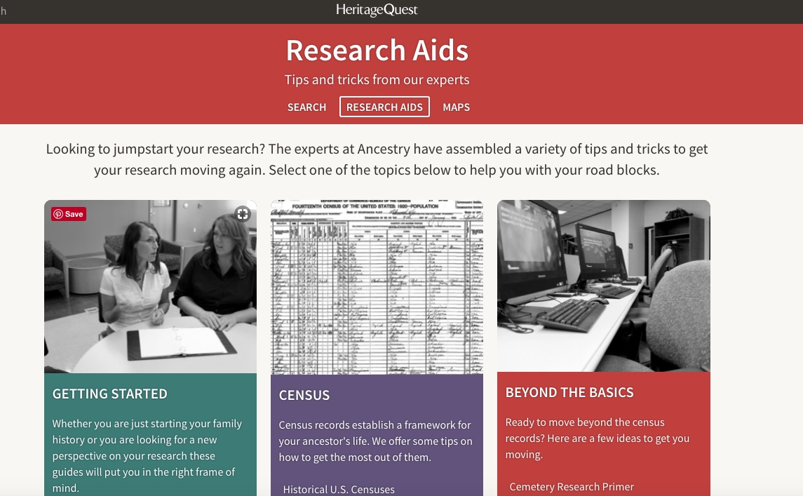
Research Aids

Slide 25
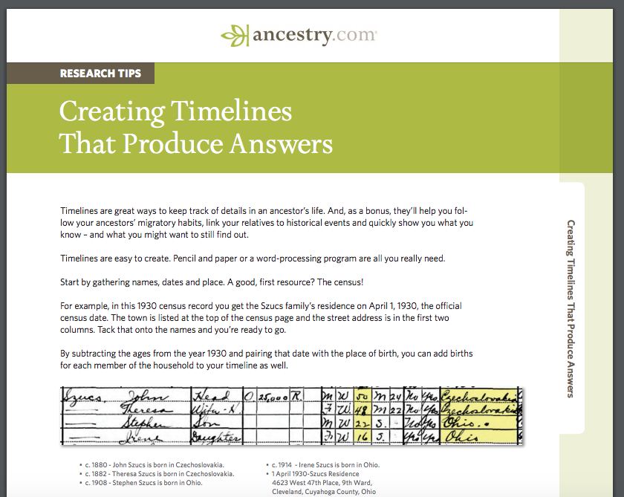
Beginning Tip

Slide 26
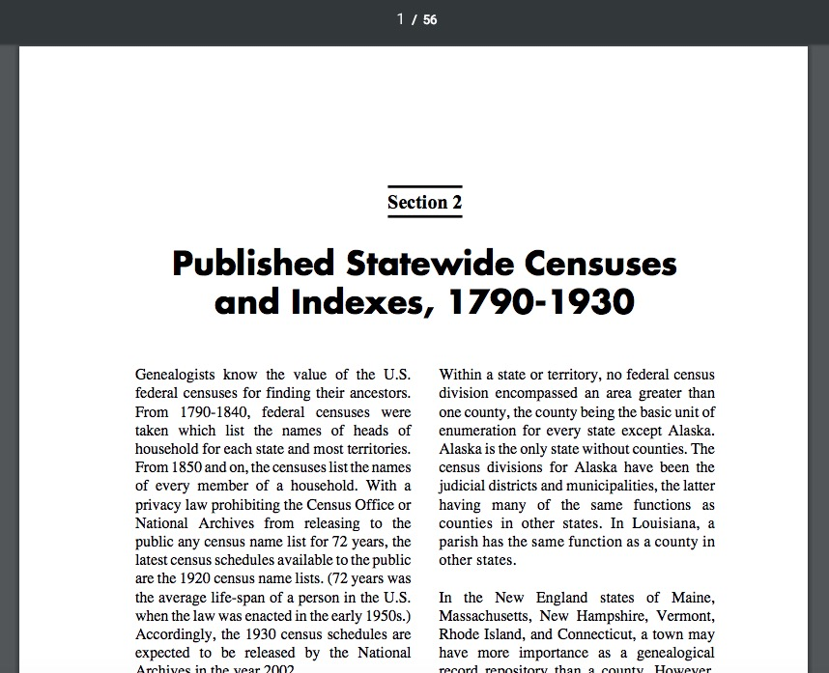
Census Tip

Slide 27
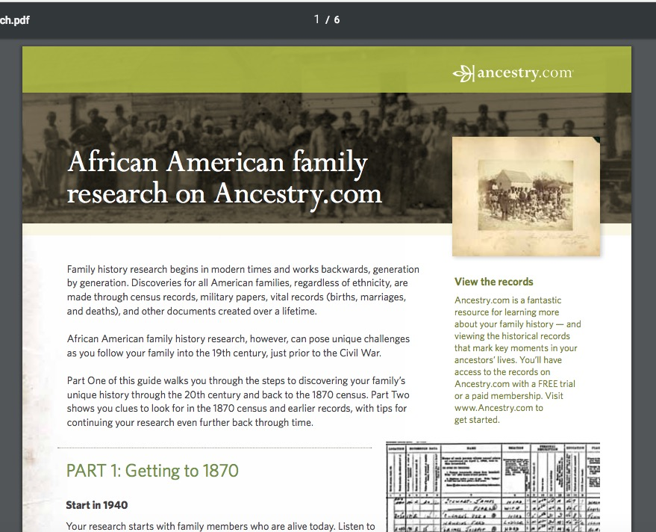
Beyond the Basics Tip

